Slide 1


Presentation on Bright Mentor
Guided By: Presented By:
Prof. Monika Choudhary Shubham siloriya 0827CD221068
Deepak patel 0827CD221024
Devansh verma 0827CD221026
Vasu soni 0827CD221075

Slide 2
Contents
Introduction
1.1 Overview
1.2 Purpose
Requirement Engineering
2.1 Requirement Collection
2.2 Functional Requirements
2.3 Non Functional Requirements
2.4 Use Case Diagram
Technical Design
3.1 Technical Architecture
3.2 Sequence Diagram
3.3 Class Diagram
3.4 DFD
User Interface Design
Data Design
5.1 Schema Design
5.2 E-R Diagram
REFERENCES

Slide 3
1. Introduction
1.1 Overview
Provide a comprehensive online platform for students.
Assist students in navigating their career paths.
Offer personalized career advice and tools for self-assessment
1.2 Purpose
Include features like career quizzes, job role databases, and resume templates.\
Empower students to make informed decisions about their futures and enhance employability.

Slide 4
2. Requirement Engineering Systematic process of gathering, analyzing, and documenting requirements.Ensures the final product meets user and stakeholder needs. 2.1 Requirement Collection Methods:Surveys and Questionnaires: Gather feedback on user needs. Interviews: Conduct discussions with students and mentors. Workshops: Organize collaborative sessions for brainstorming .

Slide 5
2.2 Function Requirements
User Registration and Authentication: Registration with username, email, and password. Secure login and logout functionality. Password recovery options.
Career Quiz: Assess interests, strengths, and skills.Suggest potential career paths based on quiz results.
Job Role Database: Maintain a database of job roles with descriptions and requirements. Search and filter job roles.
Resume Template Generation: Allow users to fill in details and generate a resume template. Options to download or print resumes.

Slide 6
2.2 Non Functional Requirements
Performance: Support up to 1000 concurrent users.Page load times under 2 seconds.
Usability: Intuitive and easy-to-navigate interface.Clear error messages and guidance.
Security: Secure password storage with encryption.Measures to prevent unauthorized access.
Scalability: Support for new features and functionalities.Database design for increasing users and data.
Reliability: 99.9% uptime for availability. Regular backups to prevent data loss.

Slide 7
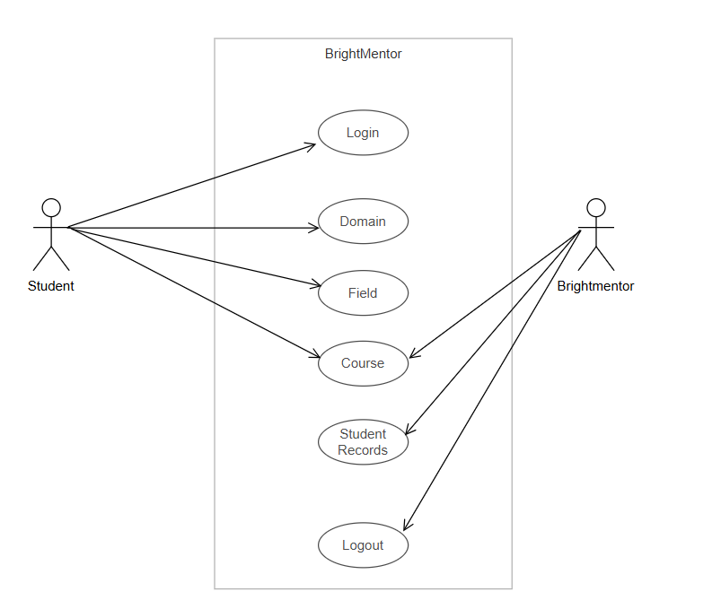
2.3 Use Case Diagram

Slide 8
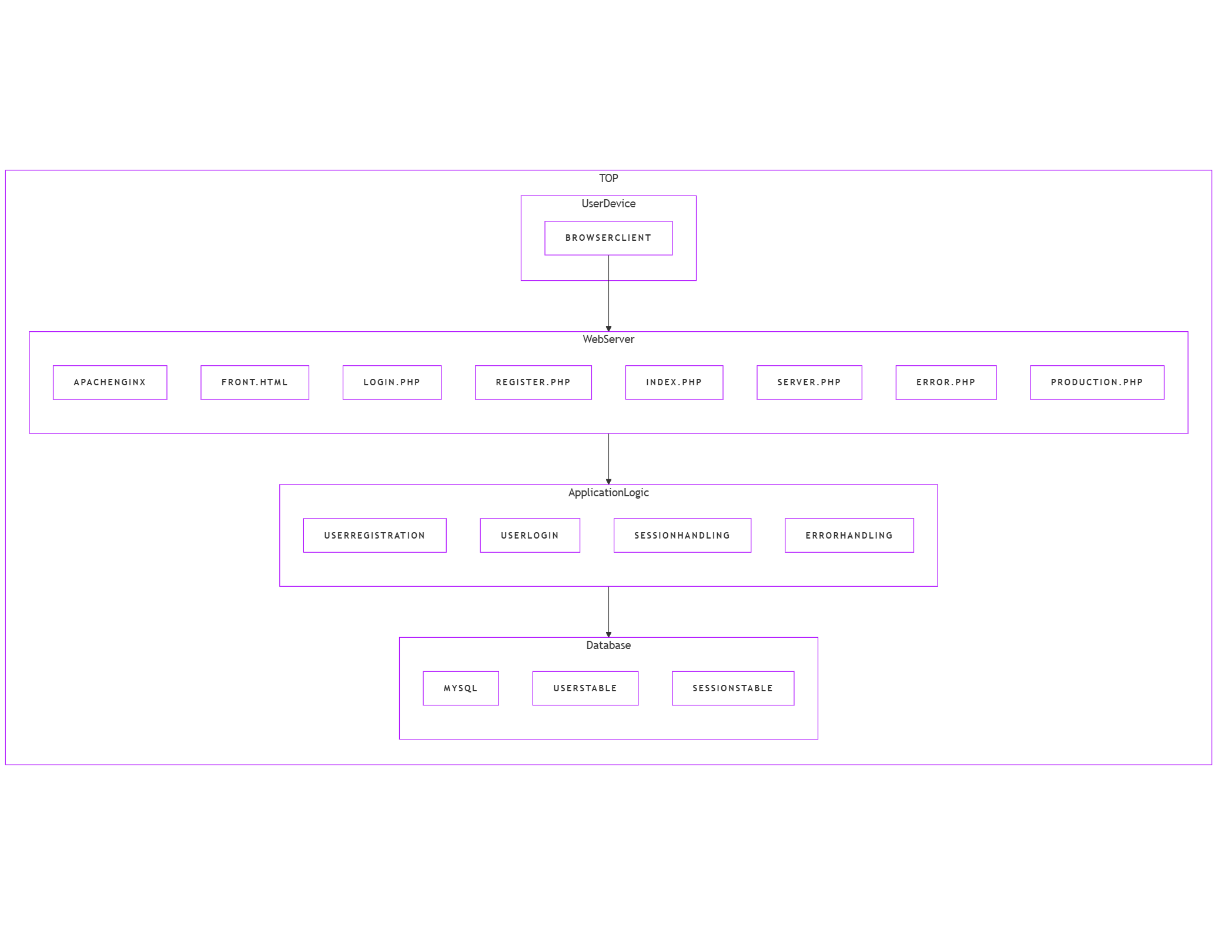
3. Technical Design 3.1 Technical Architecture

Slide 9
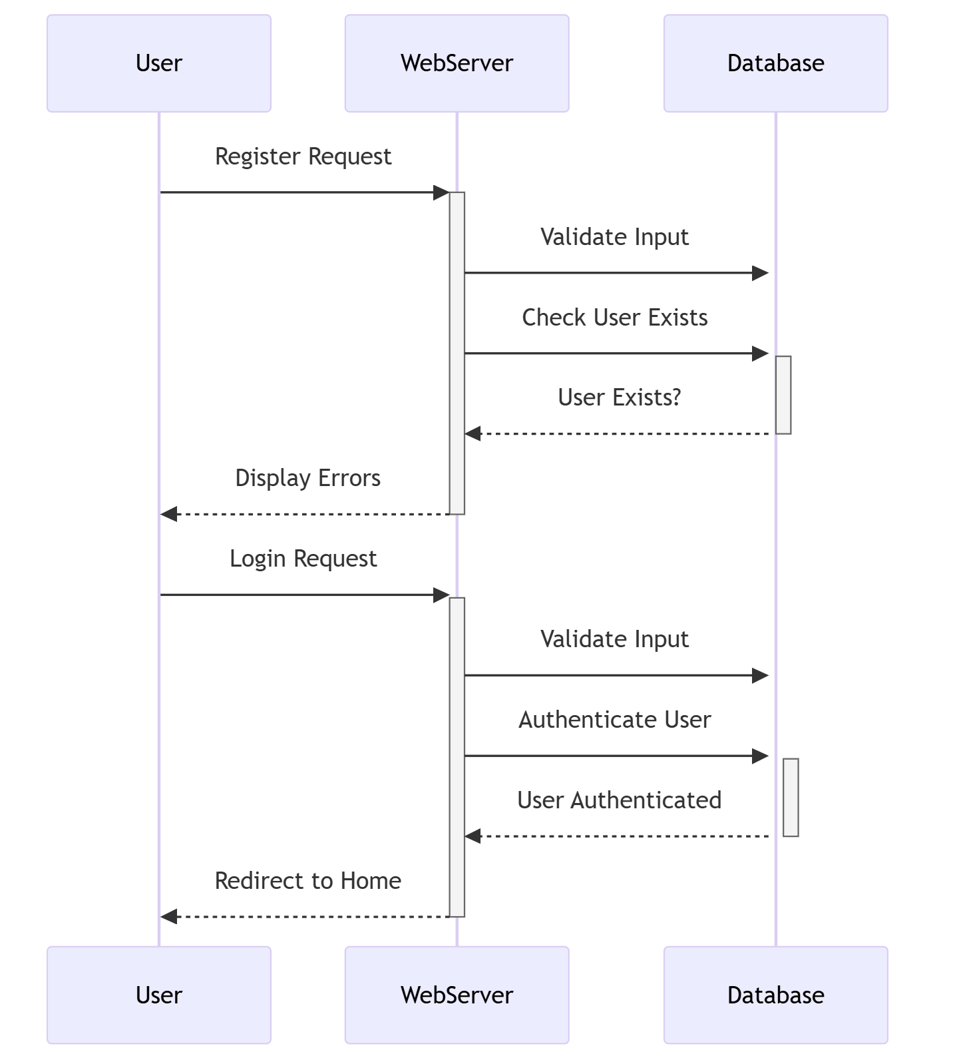
3.2 Sequence Diagram

Slide 10
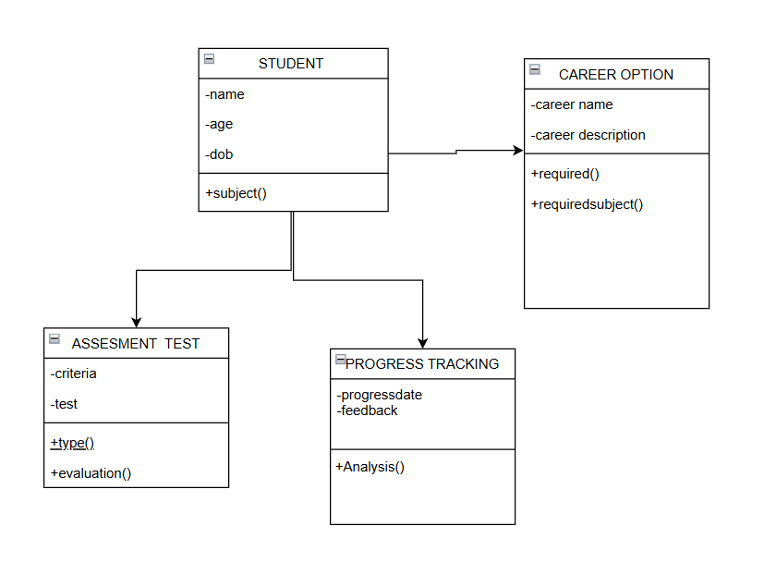
3.3 Class Diagram

Slide 11
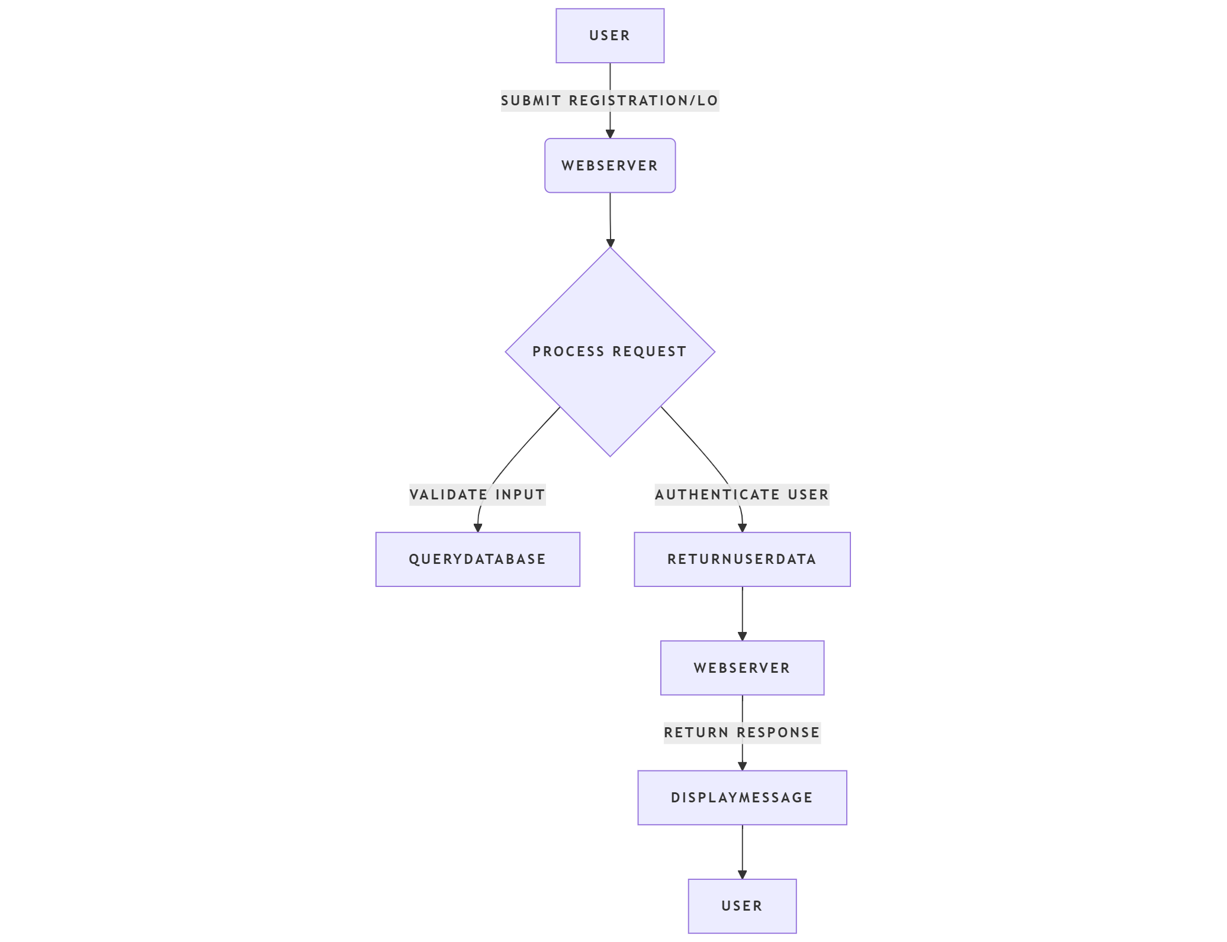
3.4 DFD
DFD Diagram

Slide 12
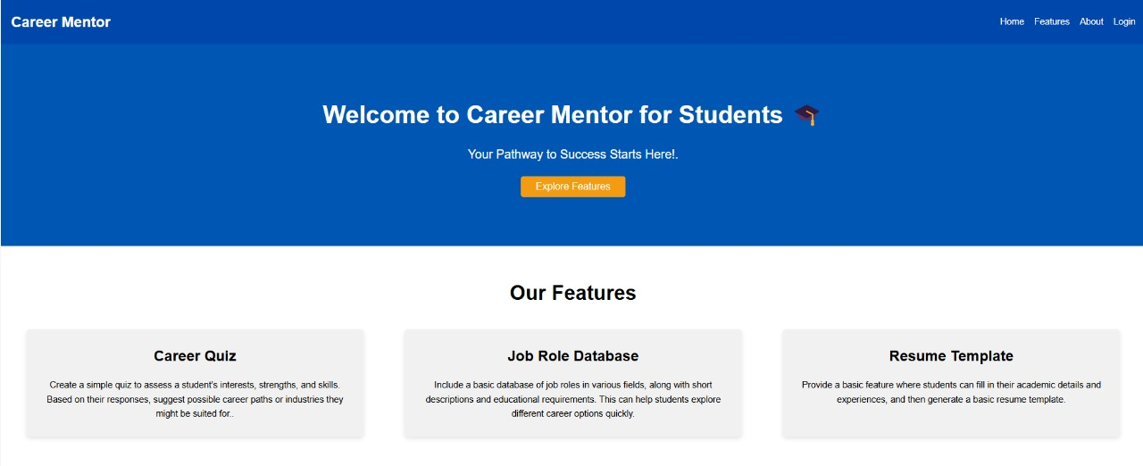
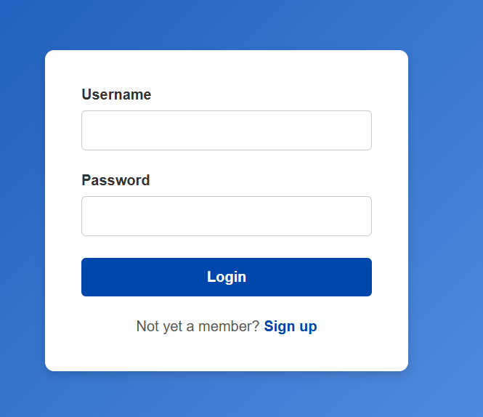
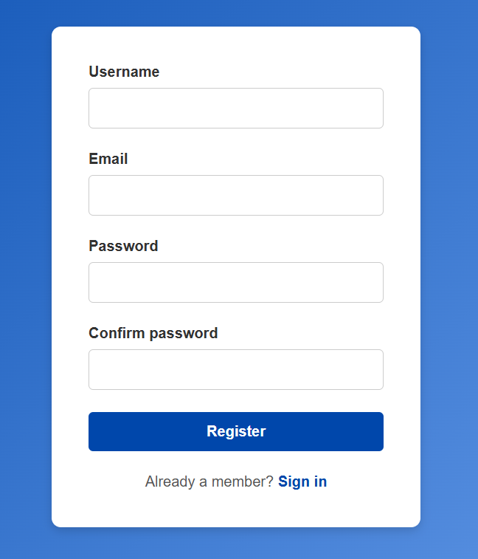
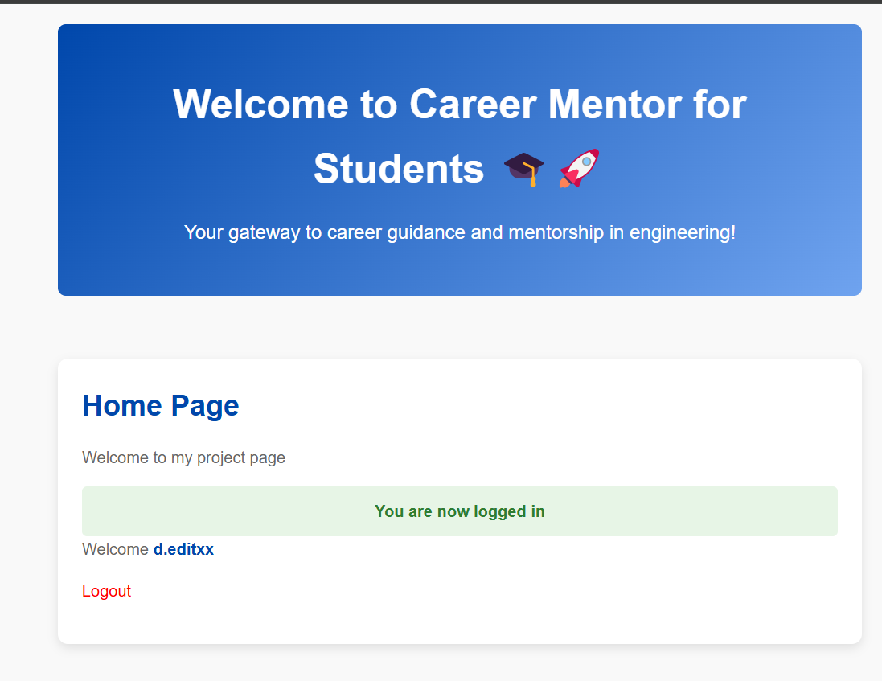
4. User Inface Design

Slide 13
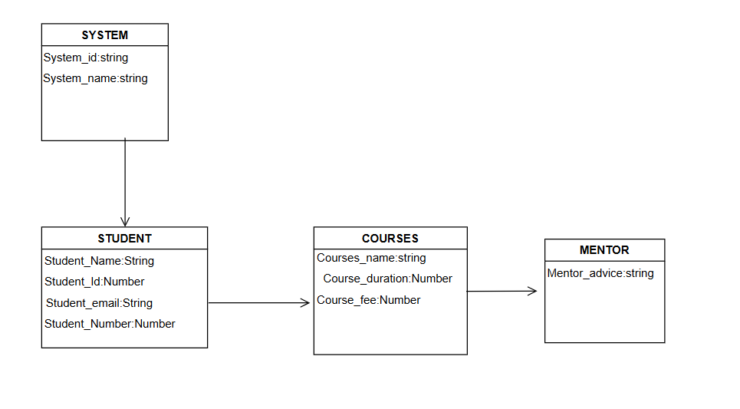
4. Data Design 4.1 Schema Definition
. A schema definition is a blueprint or structure that describes how data is organized, stored, and validated in a system. It defines the types, attributes, relationships, and rules governing data

Slide 14
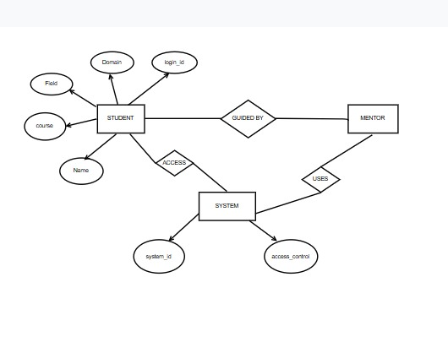
4.2 E-R Diagram

Slide 15
GitHub Link
Enter the link of GitHub repository

Slide 16
REFERENCES
"The Mentor's Guide"
Becoming a Master Student" by Dave Ellis – While primarily a study guide, this book touches on the importance of mentorship in academic settings.
Write the references used in the study(in given format only).
The Mentor's Guide" by Lois J. Zachary – A practical guide on building and sustaining mentor-mentee relationships.

Slide 17
Thank You
Queries ?

